Slide 1

PROJECT – JOB ANALYTICS
BATCH – PT-DA15
DAKSH KAYAT (pd15_297)
SAMRUDH SAMARTH (pd15_320)
INSHA ALI (pd15_216)
RAJPREET (pd15_066)

Slide 2
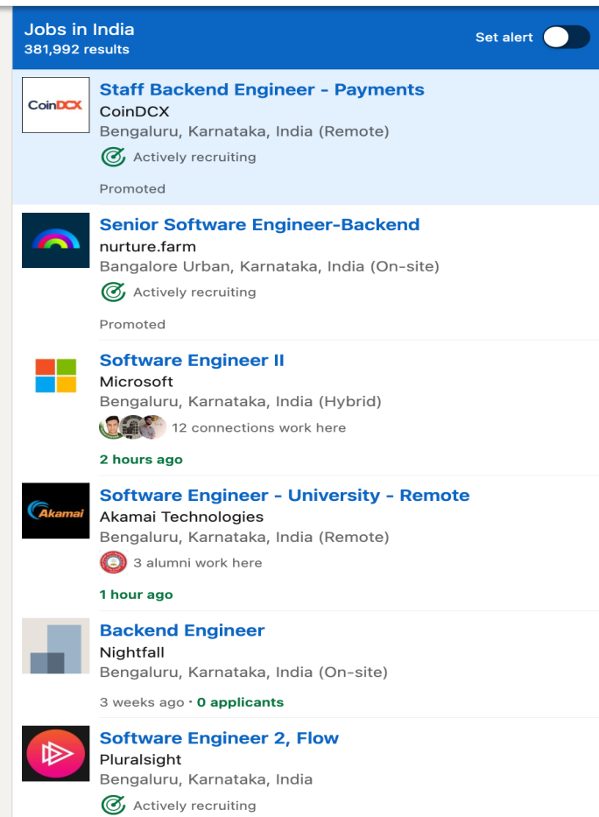
Introduction of project Job Analytics
Scrape data from professional networking platform Linkedin using python library called Beautifulsoup (or similar) and collate information in the given format and make 3 tables using the data. We have to scrap the data from the website after that we have to analise the data what we scrap out of the linkedin webpage and make the insights out of the data in the form of visulas and graphs

Slide 3
Activities are perform in project
Scraping the data from LinkedIn by using Python script.
Clean the Data and Make the Excel table.
Give the primary key and Foreign key to 3 different Tables.
Analyse the data and make insight out of it.
SQL query form Generate some insights.
Preparation of the dashboard.

Slide 4
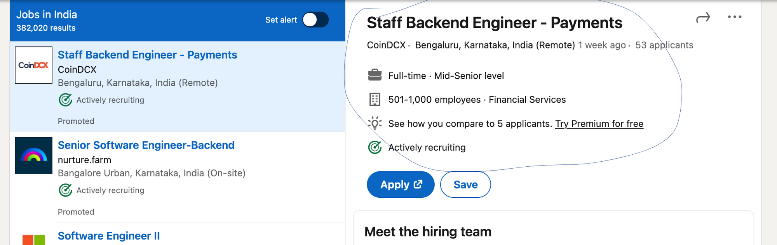
What are the data we scrap out from the LinkedIn webpage?
The designation, Company, Location, No. of applicants, Involvement, Level, No. of Employees, Industry

Slide 5
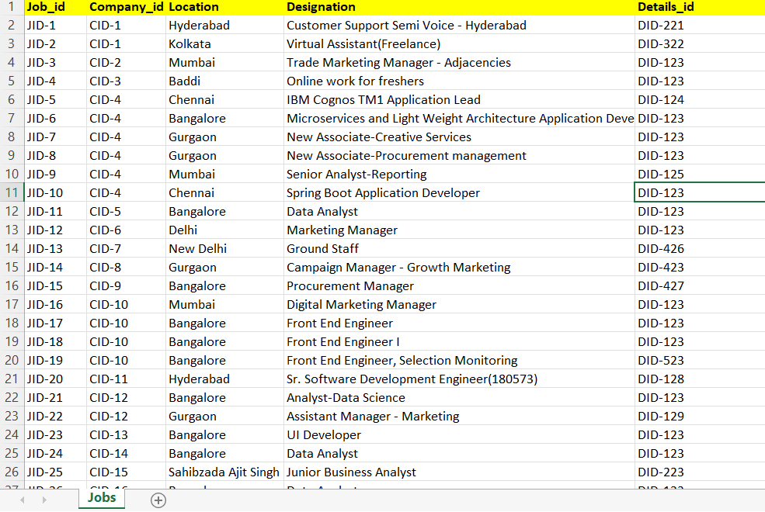
Jobs Table

Slide 6
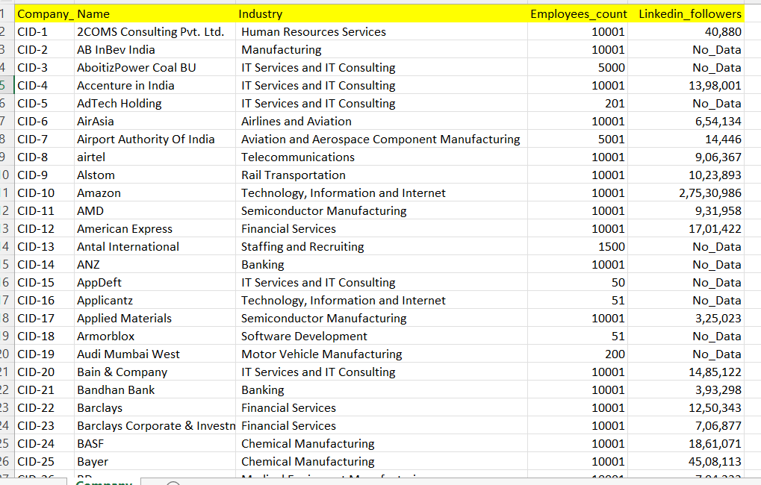
Company Table

Slide 7
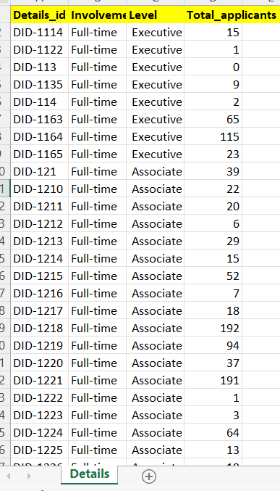
Details Table

Slide 8
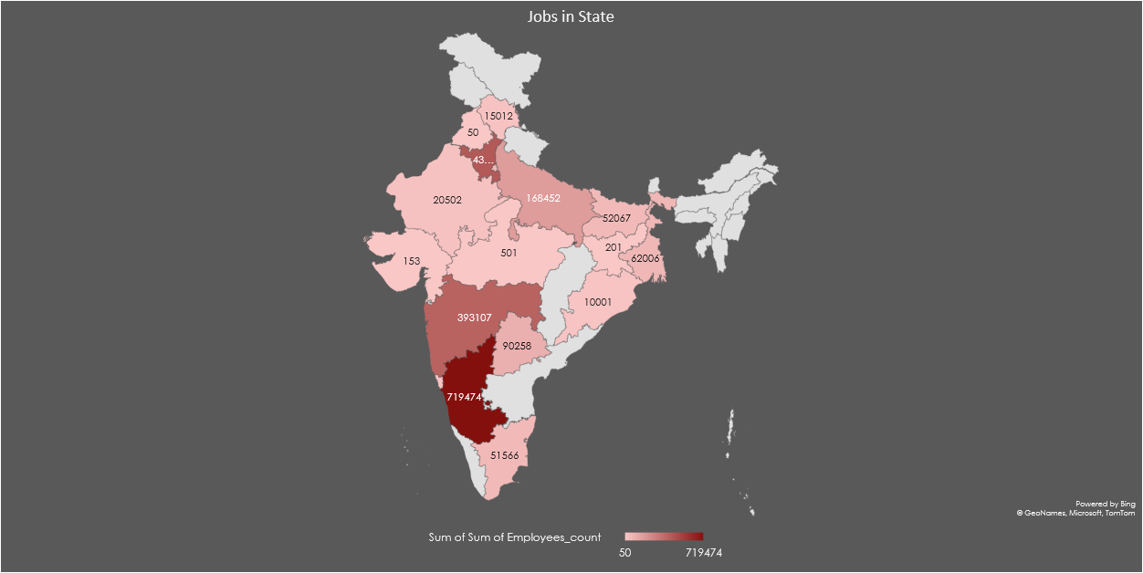
Employees in State

Slide 9
TOP 10 INDUSTRY BASED ON JOBS
Row Labels | Sum of Employees_count
IT Services and IT Consulting | 443916
Banking | 160016
Software Development | 143849
Financial Services | 127264
Manufacturing | 122532
Airlines and Aviation | 120012
Food and Beverage Manufacturing | 85009
Technology, Information and Internet | 78178
Business Consulting and Services | 76016
Motor Vehicle Manufacturing | 70407

Slide 10
Comparison of number of jobs across different cities for different level

Slide 11
Comparison of number of jobs across different cities for different level

Slide 12
Number of opening in a company with more than 1000 employees in comparison to number of openings in a company with 100 employees

Slide 13
Popular company among LinkedIn Users The Data show Amazon is one of the favourite company among users.
Company _Name | Industry | Linkedin_followers | Ranking
Amazon | Technology, Information | 27530986 | 1
Unilever | Manufacturing | 17909484 | 2
Microsoft | Software Development | 17768681 | 3
Deloitte | Business Consulting and Services | 10638787 | 4
Johnson & Johnson | Hospitals and Health Care | 7989574 | 5
Procter & Gamble | Manufacturing | 7039109 | 6
The Coca-Cola Company | Food and Beverage Services | 6949275 | 7
EY | Accounting | 6650151 | 8
Wipro | IT Services and IT Consulting | 6068496 | 9
Infosys | IT Services and IT Consulting | 6067023 | 10
The Walt Disney Company | Entertainment Providers | 5191612 | 11
HP | IT Services and IT Consulting | 5100806 | 12
Bayer | Chemical Manufacturing | 4508113 | 13
Dell Technologies | IT Services and IT Consulting | 4169043 | 14
Salesforce | Software Development | 3917830 | 15

Slide 14
Top 10 Industry in terms of no. applicants. → IT Services and IT Consulting Rank 1st in terms of the number of applicants. That shows the market trends and the applicant’s priority.
Industry | Total_applicants | Ranking
IT Services and IT Consulting | 1186 | 1
Manufacturing | 609 | 2
Technology, Information and Internet | 591 | 3
Financial Services | 461 | 4
Human Resources Services | 416 | 5
Airlines and Aviation | 316 | 6
Business Consulting and Services | 270 | 7
Software Development | 267 | 8
Newspaper Publishing | 192 | 9
Technology, Information and Media | 191 | 10

Slide 15
TOP 10 EMPLOYMENT LOCATION BASED ON NUMBER OF EMPLOYEES
LOCATION | Sum of Employees_count
Bangalore | 698462
Gurgaon | 420961
Mumbai | 220437
Pune | 96661
Hyderabad | 90258
Kalyanpur | 75701
Imamganj | 52067
Delhi | 42023
Mumbai | 41005
Noida | 40704

Slide 17
Industry Employment comparison

Slide 18
Analysis – Good News for data Analytics students, Date Analyst Requirement is the highest.

Slide 19
TOP 5 DEMANDING DESIGNATION BASED ON OPENINGS
DESIGNATION | Count of Job_id
Data Analyst | 30
Associate | 10
Marketing Manager | 7
Frontend Developer | 7
Product Manager Full Time Opportunity for University Graduates | 5

Slide 20
EMPLOYEES INVOLVEMENT
Row Labels | Count of Job_id
Business | 3
Contract | 8
Full-time | 335
Internship | 8
Part-time | 7
Temporary | 1
Grand Total | 362

Slide 21
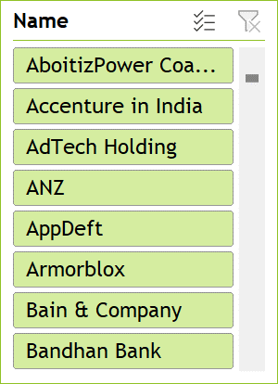
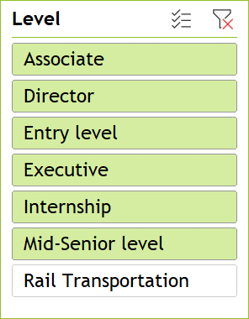
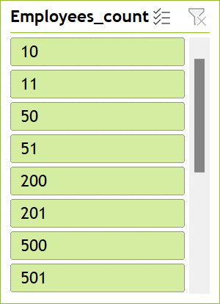
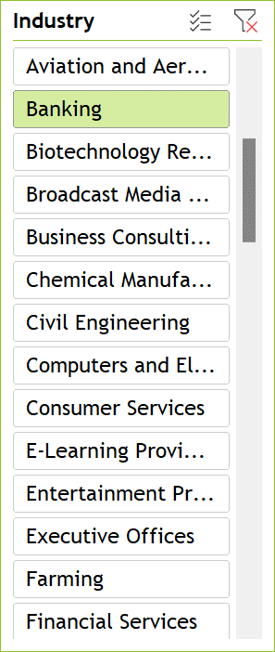
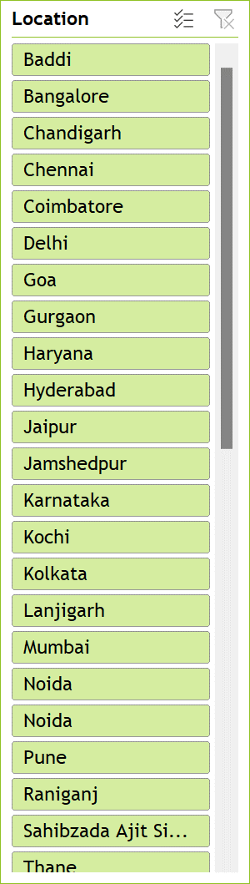
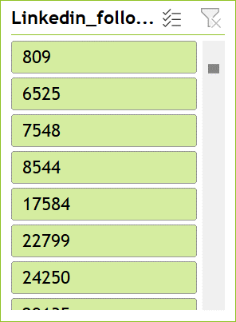
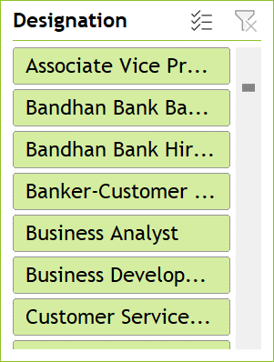
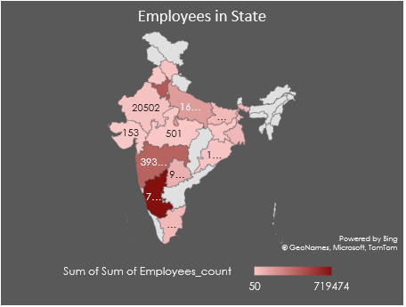

Slide 22
List of City who are leading in various Industries.
Industry | City
Appliances, Electrical, and Electronics Manufacturing | Pune
Transportation, Logistics, Supply Chain and Storage | Bangalore
Accounting | Bangalore
Airlines and Aviation | Delhi
Automation Machinery Manufacturing | Bangalore
Aviation and Aerospace Component Manufacturing | New Delhi
Banking | Chennai
Biotechnology Research | Bangalore
Chemical Manufacturing | Bangalore
Civil Engineering | Gurgaon
Computers and Electronics Manufacturing | Gurgaon
E-Learning Providers | Bangalore
Executive Offices | Hyderabad
Food and Beverage Manufacturing | Imamganj
Food and Beverage Services | Bangalore
Hospitality | Gurgaon
Hospitals and Health Care | Gurgaon
Industrial Machinery Manufacturing | Bangalore
Information Services | Bangalore
Insurance | Bangalore
Machinery Manufacturing | Bangalore
Market Research | Bangalore
Mining | Kolkata
Musicians | Mumbai
Newspaper Publishing | Nagpur
Pharmaceutical Manufacturing | Gurgaon
Professional Services | Bangalore
Rail Transportation | Bangalore
Retail Luxury Goods and Jewelry | Bangalore
Semiconductor Manufacturing | Hyderabad
Telecommunications | Bangalore
Textile Manufacturing | Kalyanpur
Tobacco Manufacturing | New Delhi
Transportation Equipment Manufacturing | Gurgaon
Truck Transportation | Kalyanpur
Wholesale Building Materials | Imamganj
By analysis of data.
Bangalore led in IT Industry
Pune led in Electronics Industry

Slide 23
Thanks you

